Slide 1
SuperPoints
REESE WILLIAMS
JOHN HOANG | OLIVER JANG | HENRY JIANG | HARMAN MINHAS

Slide 2

The Idea

Slide 3



Slide 4
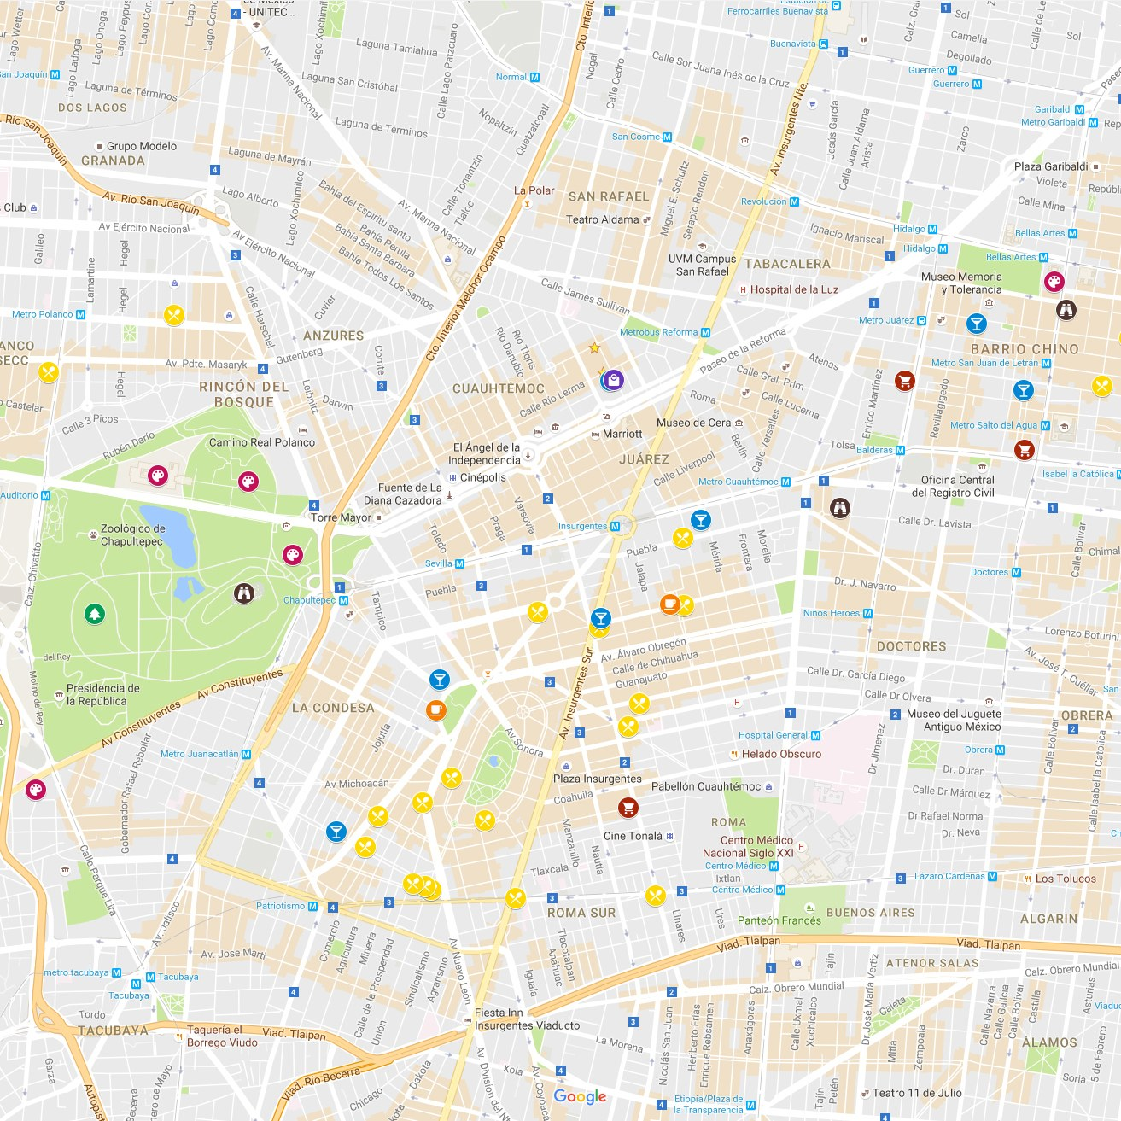



Created detection of a customer within a store Created detection of businesses within a consumers area
Awarded points to be used for promotions
Created backend database

Slide 5
demo

Slide 6
challenges
devices
school
database

Slide 7

The
Future
SuperPoints
Modern design
More business value
Production

Slide 8
?

